Slide 1


Creation of simple network topology using cisco packet tracer
Creation of simple network topology using cisco packet tracer
Final Evaluation
Group no -8
Abhay Solan(2021A1L006)
Aryan Sharma(2020A1R194)
Aryan Sharma(2020A1R183)
CSE - 5th semester
Presenter
Aryan Sharma(2020A1R183)
CSE - 5th semester
DEPARTMENT OF COMPUTER SCIENCE AND ENGINEERING
MIET(Autonomous), JAMMU
DEPARTMENT OF COMPUTER SCIENCE AND ENGINEERING
MIET(Autonomous), JAMMU

Slide 2
Contents
Network Topology
Types of Network Topology
Switch
Hubs
End Devices
Cisco Packet Tracer
Description of Project

Slide 3
Network Topology
A network topology is the physical and logical arrangement of nodes and connections in a network.
Nodes usually include devices such as switches, routers and software with switch and router features.
Network topologies are often represented as a graph.
Network topology plays a major role in how a network functions.
Choosing the right topology can help increase performance.

Slide 4
Types of Network Topology
Mesh Topology
Star Topology
Bus Topology
Ring Topology
Hybrid Topology

Slide 5
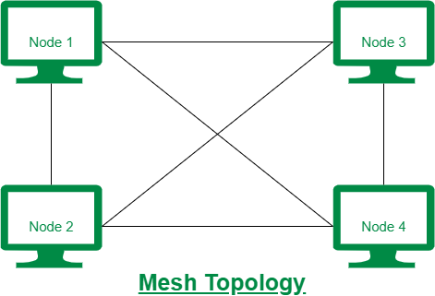
Mesh topology
A mesh topology is a network setup where each computer and network device is interconnected with one another.
This topology setup allows for most transmissions to be distributed even if one of the connections goes down.
It is a topology commonly used for wireless networks.

Slide 6
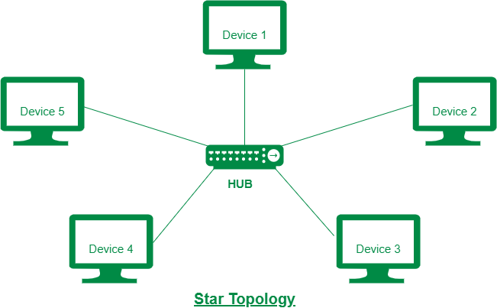
Star Topology
Star topology is a network topology in which each network component is physically connected to a central node such as a router, hub or switch.
In a star topology, the central hub acts like a server and the connecting nodes act like clients.
A star topology is also known as a star network.

Slide 7
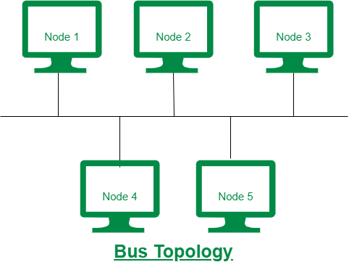
Bus Topology
Bus topology is a network setup where each computer and network device is connected to a single cable or backbone.
Depending on the type of computer network card, a coaxial cable or an RJ-45 network cable is used to connect them together.
A bus topology is also known as a line topology.

Slide 8
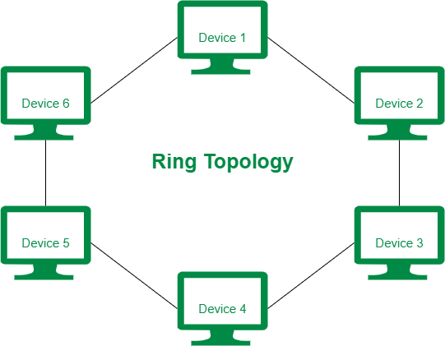
Ring Topology
Ring topology is a type of network topology in which each device is connected to two other devices on either side via an RJ-45 cable or coaxial cable.
This forms a circular ring of connected devices which gives it its name.
Data is commonly transferred in one direction along the ring, known as a unidirectional ring.

Slide 9
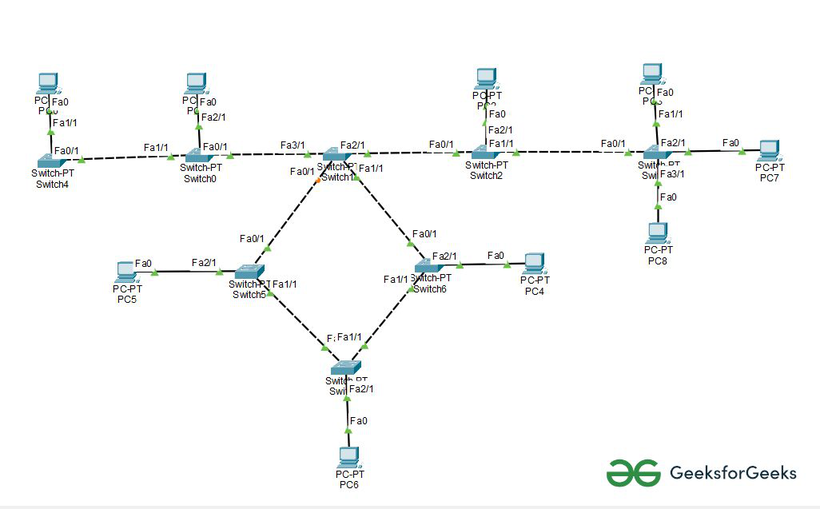
Hybrid Topology
A hybrid topology is a type of network topology that uses two or more differing network topologies.
These topologies can include a mix of bus topology, mesh topology, ring topology, star topology, and tree topology.
The two most commonly used types of hybrid topologies are Star-Ring hybrid topology and Star-Bus hybrid topology.

Slide 10
Hubs
A hub is a physical layer networking device which is used to connect multiple devices in a network.
They are generally used to connect computers in a LAN.
A hub has many ports in it.
A computer which intends to be connected to the network is plugged in to one of these ports.
When a data frame arrives at a port, it is broadcast to every other port, without considering whether it is destined for a particular destination or not.

Slide 11
Switches
A switch is a data link layer networking device which connects devices in a network and uses packet switching to send and receive data over the network.
Like a hub, a switch also has many ports, to which computers are plugged in.
When a data frame arrives at any port of a network switch, it examines the destination address and sends the frame to the corresponding device(s).
It supports both unicast and multicast communications.

Slide 12
End Devices
End devices are the node devices that serve as a source point or a destination point in the communication that occurs on a computer network.
With the coming advancements in computer networking systems, we have nodes that can act as a client, a server, or both.
End Devices as Clients – Perform the tasks of requesting data, displaying received data, etc. meant usually for the usage by end clients.
End Devices as Servers – Equipped with programs that provide information and services such as webpages or e-mails to other nodes (or hosts) on the network.

Slide 13
Cisco Packet Tracer
This tool provides a network simulation to practice simple and complex networks.
The main purpose of Cisco Packet Tracer is to help students learn the principles of networking with hands-on experience as well as develop Cisco technology specific skills.
Since the protocols are implemented in software only method, this tool cannot replace the hardware Routers or Switches.

Slide 14
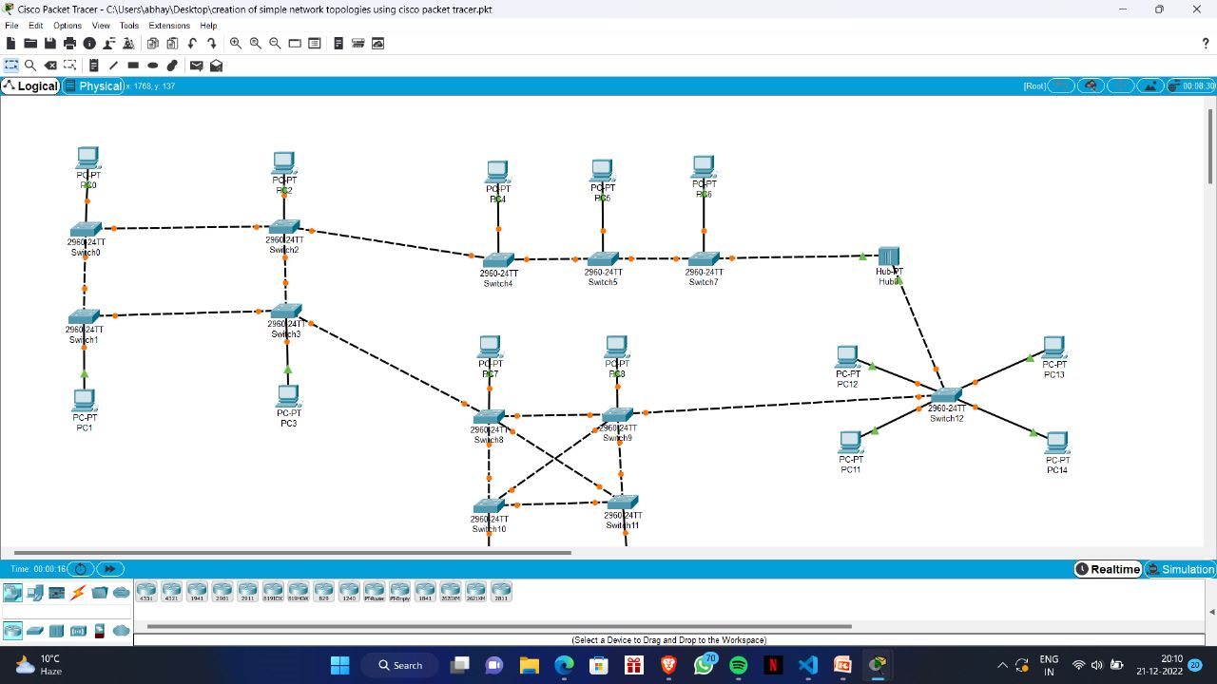

Slide 15
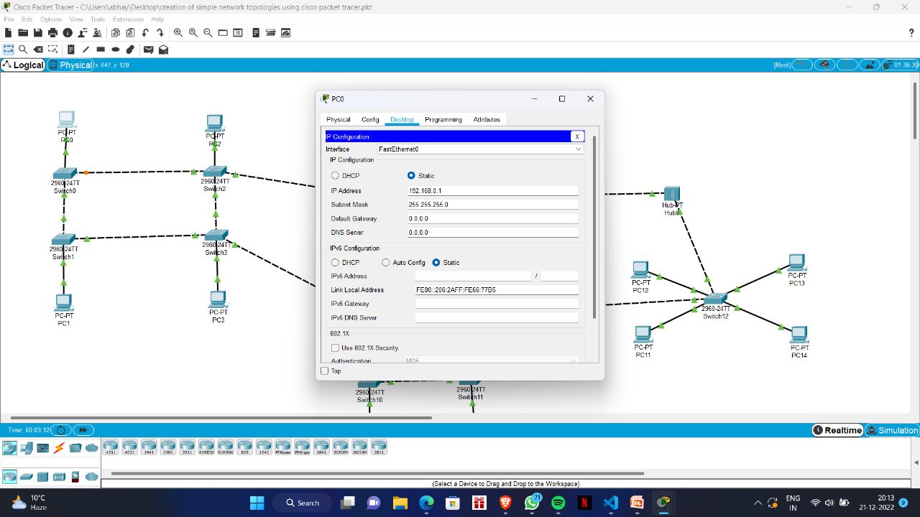

Slide 16


